Slide 1
Operating System
Lecture 18: I/O Systems
Manoj Kumar Jain
M.L. Sukhadia University Udaipur

Slide 2
Outline
I/O Hardware
Application I/O Interface
Manoj Kumar Jain Professor Computer Science MLSU Udaipur

Slide 3
I/O Hardware
Incredible variety of I/O devices
Common concepts
  Port
  Bus (daisy chain or shared direct access)
  Controller (host adapter)
I/O instructions control devices
Devices have addresses, used by
  Direct I/O instructions
  Memory-mapped I/O
Manoj Kumar Jain Professor Computer Science MLSU Udaipur

Slide 4
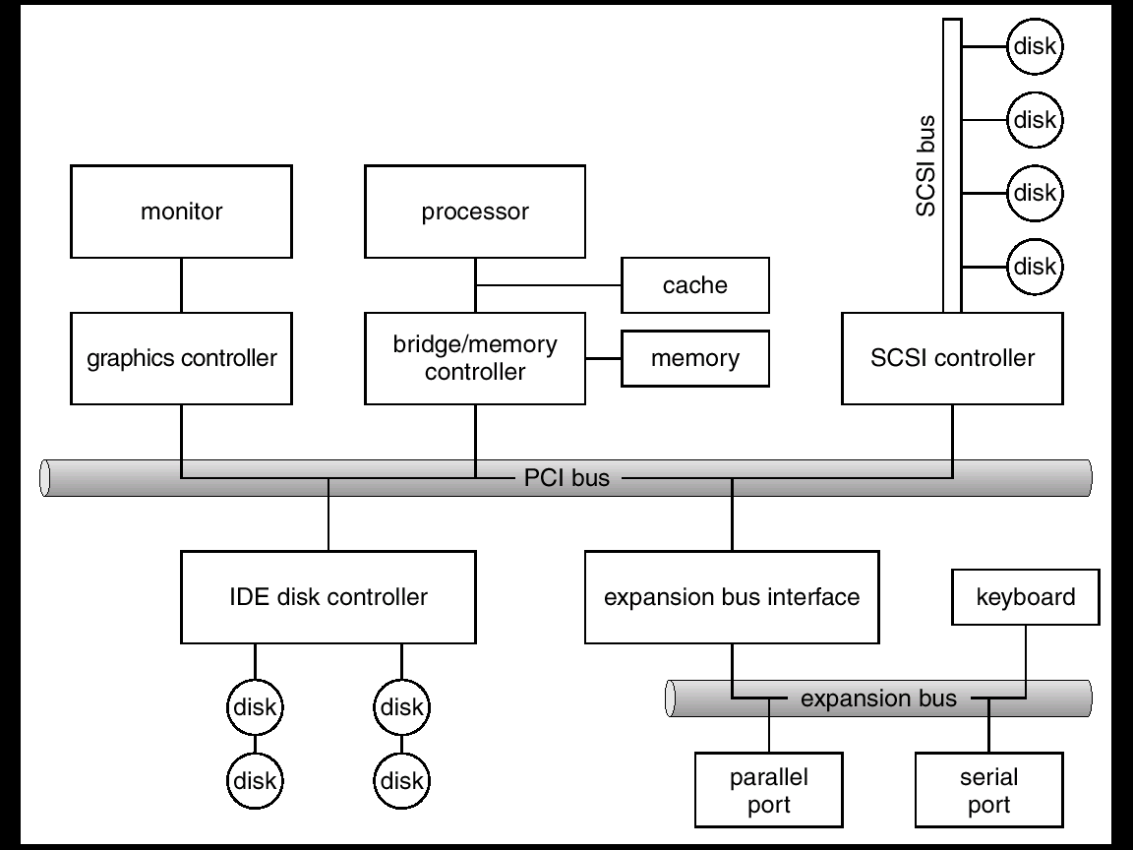
A Typical PC Bus Structure
Manoj Kumar Jain Professor Computer Science MLSU Udaipur

Slide 5
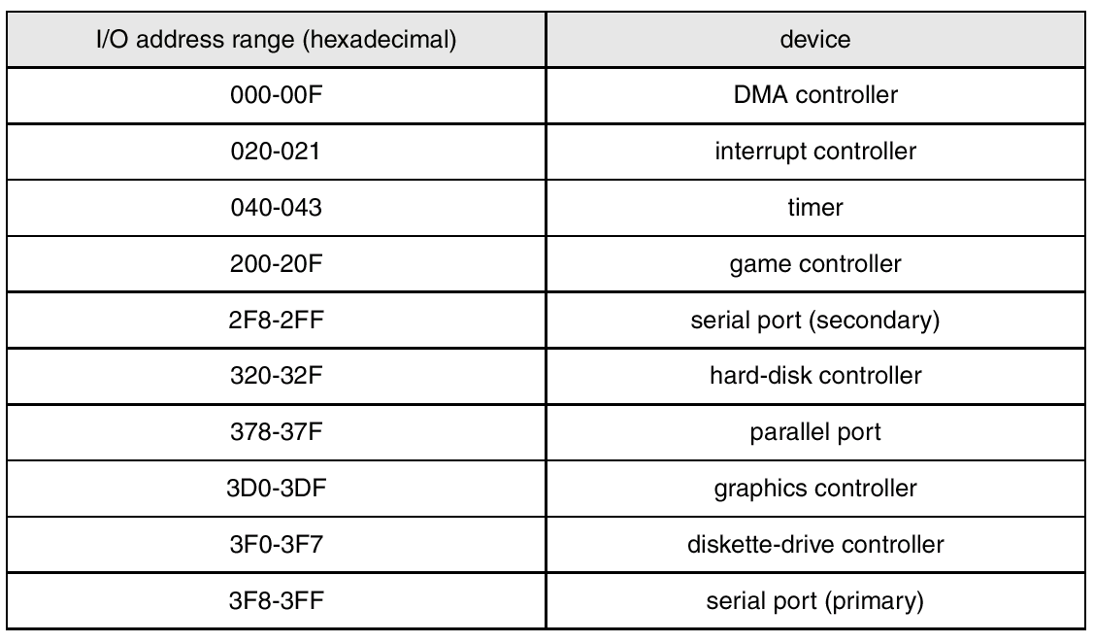
Device I/O Port Locations on PCs (partial)
Manoj Kumar Jain Professor Computer Science MLSU Udaipur

Slide 6
Polling
Determines state of device
  command-ready
  busy
  Error
Busy-wait cycle to wait for I/O from device
Manoj Kumar Jain Professor Computer Science MLSU Udaipur

Slide 7
Interrupts
CPU Interrupt request line triggered by I/O device
Interrupt handler receives interrupts
Maskable to ignore or delay some interrupts
Interrupt vector to dispatch interrupt to correct handler
  Based on priority
  Some unmaskable
Interrupt mechanism also used for exceptions
Manoj Kumar Jain Professor Computer Science MLSU Udaipur

Slide 8
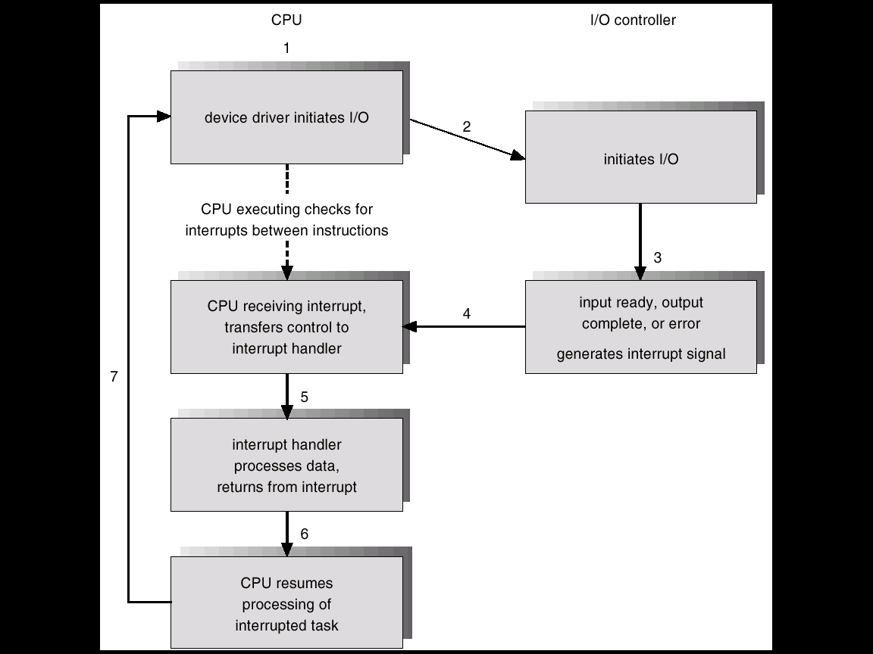
Interrupt-Driven I/O Cycle
Manoj Kumar Jain Professor Computer Science MLSU Udaipur

Slide 9
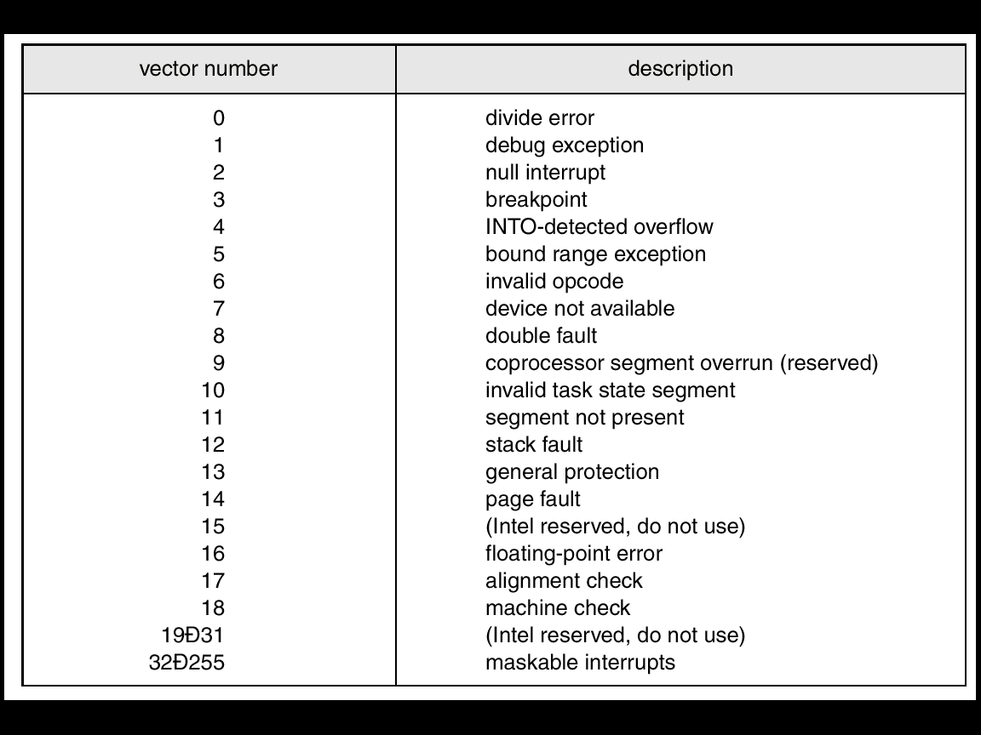
Intel Pentium Processor Event-Vector Table
Manoj Kumar Jain Professor Computer Science MLSU Udaipur

Slide 10
Direct Memory Access
Used to avoid programmed I/O for large data movement
Requires DMA controller
Bypasses CPU to transfer data directly between I/O device and memory
Manoj Kumar Jain Professor Computer Science MLSU Udaipur

Slide 11

Six Step Process to Perform DMA Transfer
Manoj Kumar Jain Professor Computer Science MLSU Udaipur

Slide 12
Application I/O Interface
I/O system calls encapsulate device behaviors in generic classes
Device-driver layer hides differences among I/O controllers from kernel
Devices vary in many dimensions
  Character-stream or block
  Sequential or random-access
  Sharable or dedicated
  Speed of operation
  read-write, read only, or write only
Manoj Kumar Jain Professor Computer Science MLSU Udaipur

Slide 13
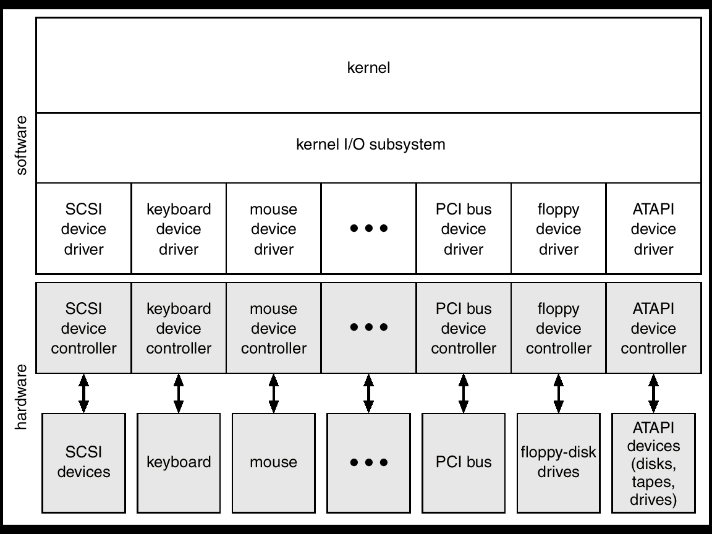
A Kernel I/O Structure
Manoj Kumar Jain Professor Computer Science MLSU Udaipur

Slide 14
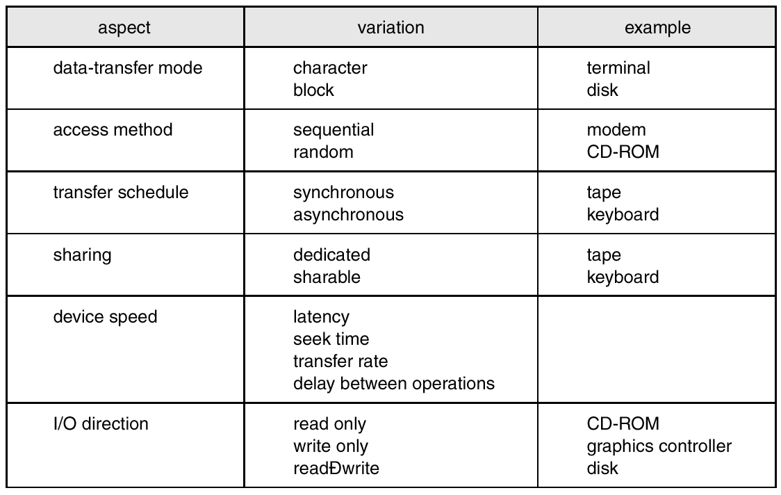
Characteristics of I/O Devices
Manoj Kumar Jain Professor Computer Science MLSU Udaipur

Slide 15
Block and Character Devices
Block devices include disk drives
  Commands include read, write, seek
  Raw I/O or file-system access
  Memory-mapped file access possible
Character devices include keyboards, mice, serial ports
  Commands include get, put
  Libraries layered on top allow line editing
Manoj Kumar Jain Professor Computer Science MLSU Udaipur

Slide 16
Network Devices
Varying enough from block and character to have own interface
Unix and Windows NT/9i/2000 include socket interface
  Separates network protocol from network operation
  Includes select functionality
Approaches vary widely (pipes, FIFOs, streams, queues, mailboxes)
Manoj Kumar Jain Professor Computer Science MLSU Udaipur

Slide 17
Clocks and Timers
Provide current time, elapsed time, timer
If programmable interval time used for timings, periodic interrupts
ioctl (on UNIX) covers odd aspects of I/O such as clocks and timers
Manoj Kumar Jain Professor Computer Science MLSU Udaipur

Slide 18
Blocking and Nonblocking I/O
Blocking - process suspended until I/O completed
  Easy to use and understand
  Insufficient for some needs
Nonblocking - I/O call returns as much as available
  User interface, data copy (buffered I/O)
  Implemented via multi-threading
  Returns quickly with count of bytes read or written
Asynchronous - process runs while I/O executes
  Difficult to use
  I/O subsystem signals process when I/O completed
Manoj Kumar Jain Professor Computer Science MLSU Udaipur

Slide 19
Thanks
Manoj Kumar Jain Professor Computer Science MLSU Udaipur

